Slide 1
Design Thinking
-Sarmila K
111622201095

Slide 2
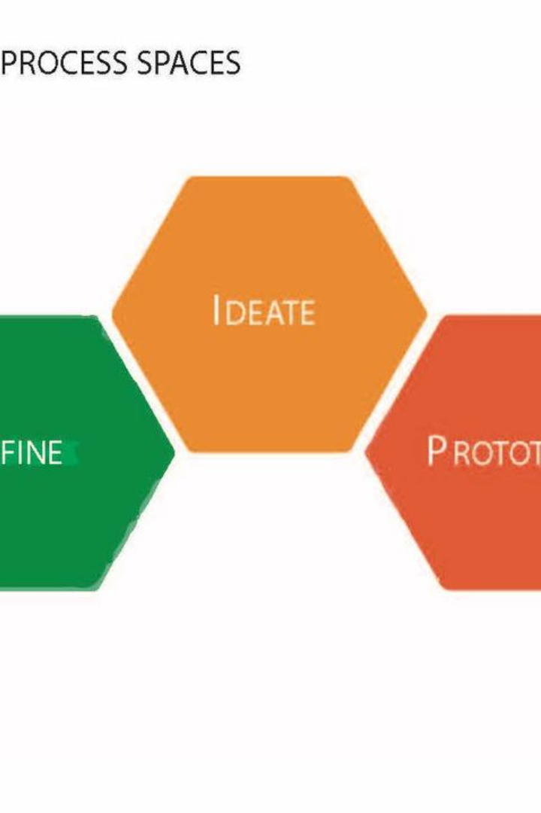
Introduction to Design Thinking
Design Thinking is a human-centered approach to problem-solving that puts empathy for users at the core. It involves a series of steps to understand complex problems, develop innovative ideas, and deliver effective solutions.
Sarmila K
111622201095

Slide 3
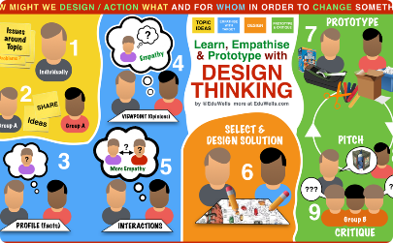
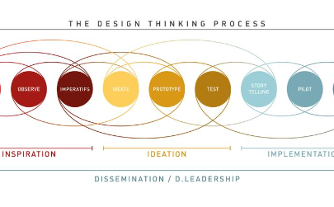

Understanding the Design Thinking process
Empathize
Define
Ideate
The first step is to empathize with the users to understand their experiences, needs, and emotions. This helps in gaining insights to define the real problem.
Defining the problem statement based on the insights and observations gathered from the empathize phase. This phase is crucial for framing the core issue to be solved.
Generating creative and varied solutions through brainstorming and exploring multiple perspectives, fostering an environment of free thinking and idea generation.

Slide 4

Empathize: The first step in Design Thinking
1
User Research
Engage with users to gather insights about their experiences, behaviors, and needs. Observations and interviews are key methods used in this process.
2
Creating Personas
Mapping out the characteristics, goals, and frustrations of potential users as a way to better understand and empathize with their perspectives.
3
Immersion in Context
It involves immersing yourself in the user's environment to truly understand their needs, challenges, and motivations.

Slide 5

Define: Defining the problem statement
Problem Statement Clarity
Constraints Identification
User Insights Synthesis
Clearly articulating the problem, ensuring that it aligns with the insights gained from the empathize phase. It sets the direction for the next stages.
Identifying the limitations and boundaries within which the solution must exist, providing a framework for the ideation phase.
Organizing and synthesizing the information collected during empathize to draw out meaningful patterns and insights.

Slide 6
Ideate: Generating creative solutions
1
Brainstorming Sessions
2
Mind Mapping
3
Creative Prototyping
Utilizing visual diagrams to generate, organize, and explore ideas, linking concepts and sparking creativity through visualization.
Conducting group brainstorming sessions to generate diverse and innovative solutions to the defined problem. Everyone's input is valued in this phase.
Encouraging unconventional thinking and embodiment of ideas through creative, low-fidelity prototypes.

Slide 7
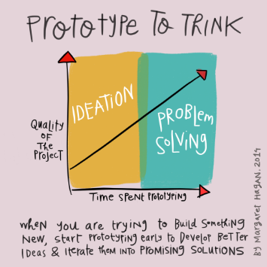
Prototype: Building and testing prototypes
Iterative Development
Feedback Loops
Rapid Iteration
Developing multiple iterations of the prototype, testing, gathering feedback, and refining the design based on user insights and interactions.
Creating feedback mechanisms to gather user feedback on the prototype's usability, functionality, and overall experience.
Quick and continuous iterations and improvements to the prototype based on feedback, allowing for rapid learning and evolution of the design.

Slide 8




Test: Gathering feedback and iterating
Usability Testing
Data Analysis
Continuous Improvement
Involve users in testing the prototype to uncover issues, discover usability problems, and validate the effectiveness of the design.
Collecting and analyzing data from tests, interviews, and user observations to identify trends and patterns, informing further iterations.
Using the insights gathered to refine and improve the prototype, ensuring that it aligns with user needs and expectations.

Slide 9
Implement: Bringing the solution to life
1
Launch Strategy
Developing a comprehensive plan for introducing the solution to the market or users, considering factors like timing and promotion.
2
User Training
Providing necessary training and support to users to ensure a smooth transition and adoption of the solution.
3
Monitoring and Evaluation
Establishing processes to monitor the performance of the solution and gathering user feedback post-implementation for further enhancements.

Slide 10

Benefits of using Design Thinking
User-Centric Solutions
Innovative Problem-Solving
It fosters the creation of products and solutions that truly meet the needs and desires of the end-users, leading to higher satisfaction.
Encourages innovative and out-of-the-box thinking, resulting in unique and effective solutions to complex problems.
Iterative Approach
Allows for iterative development, reducing the risk of costly mistakes and ensuring the final solution aligns closely with user needs.

Slide 11

Conclusion and key takeaways
1
Human-Centered Mindset
2
Continuous Improvement
Emphasizes human needs and experiences, placing users at the center of the design and problem-solving process.
Design Thinking is an iterative process, promoting continuous learning and improvement through prototyping and testing.
3
Cross-Disciplinary Collaboration
Encourages collaboration among diverse disciplines, bringing various perspectives together to solve complex challenges.

